Slide 1
Auth POC
01/01/2020

Slide 2
POC Services
Clients
Resource Providers
Identity Sources
IAM
CLIENT APPLICATION
(APP)
RESOURCE SERVER
(RS)
GREENWAY PATIENT
(GP)
PingFederate
(PF)
PingDirectory
(PD)
Relying Party
Resource Server
Account Management
Identity Provider
LDAP
FHIR API
OpenId Connect Provider
SCIM
GREENWAY SERVICE
(SPA)
GREENWAY SITE
(PM)
Identity Store
Relying Party
Authorize
Relying Party
Account
Management
Token
Data Store?
User Info
Self-Service
Password Management
Account Recovery

Slide 3
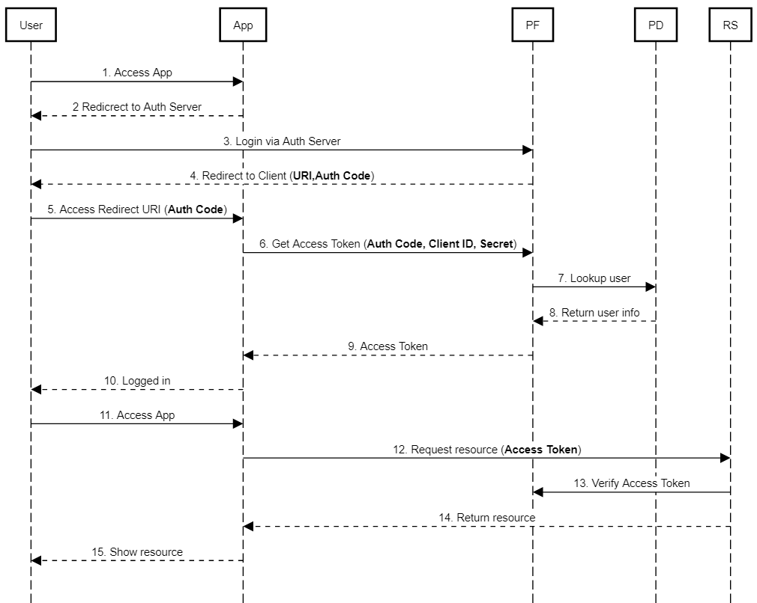
Scenario 1a – OpenId Connect Authorization Code Flow /w Confidential Client
Objective
Proof PF and PD configuration for a basic OpenId flow
Configuration
PD configured as directory/source on PF.
User already exists in PD.
RS returns access token header and claims.
Additional user attribute lookup by RS?
Acceptance Criteria
User successfully login
App returns claims to user.

Slide 4
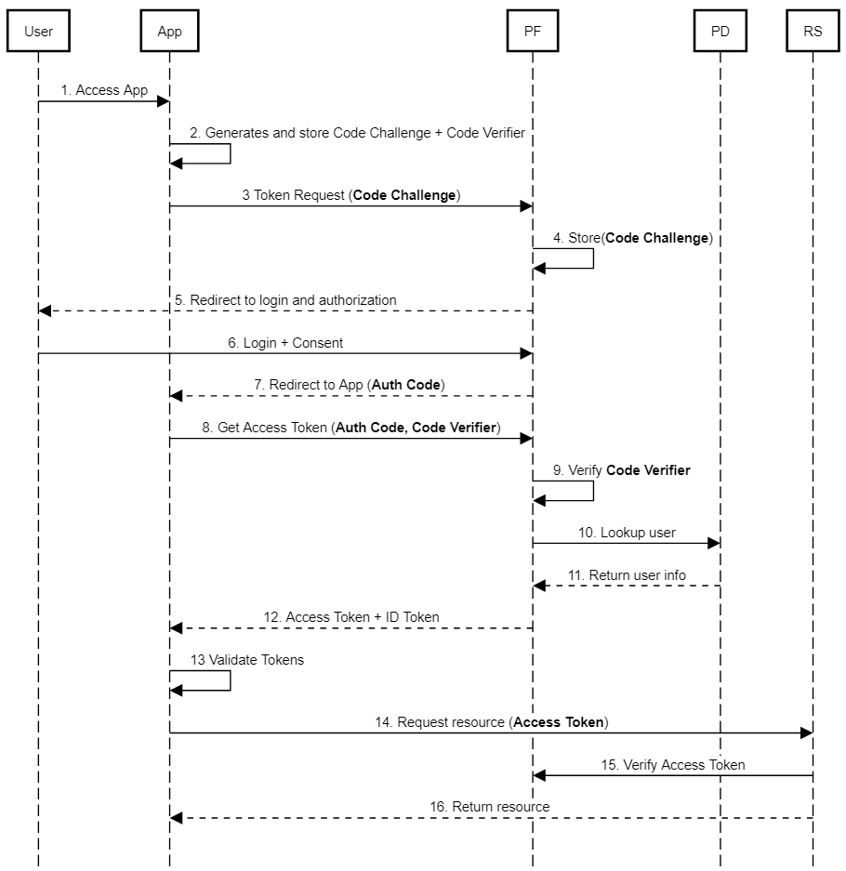
Scenario 1b – OpenId Connect Authorization Code Flow /w Public Client + PKCE
Objective
Proof PF and PD configuration for a basic OpenId flow
Configuration
PD configured as directory/source on PF.
User already exists in PD.
RS returns access token header and claims.
Additional user attribute lookup by RS?
Acceptance Criteria
User successfully login
App displays claims to user.

Slide 5
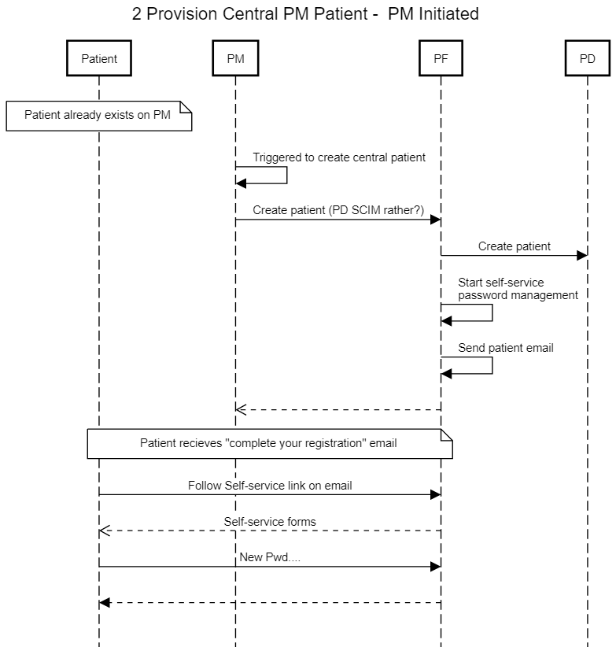
Scenario 2 – Provision PM Patient - PM Initiated

Slide 6
Terminology
Identity (ID) Token | Security token granted by the OpenID Provider that contains information about an End-User. This information tells your client application that the user is authenticated, and can also give you information like their username or locale.
Access Token | Used by application to make API requests on behalf of a user. The access token represents the authorization of a specific application to access specific parts of a user’s data.
Identity | The fact of being whom or what a person or thing is. The sameness in all that constitutes the objective reality of a thing: oneness.
Identity and Access Management (IAM) | Identity management focuses on authentication, whereas access management is aimed at authorization.
Authorization | Applying policy to permit or refuse access to an authenticated entity.
Authentication | Determining the person or entity is genuine, they are who or what they claim to be.
Client | Web-based, mobile, desktop and JavaScript applications that needs to verify the identity of an end-user based on the authentication performed by an authorization server, as well as to obtain basic profile information about the end-user in an interoperable and REST-like manner.
Resource Server | The resource server is the OAuth 2.0 term for your API server. The resource server handles authenticated requests after the application has obtained an access token.

Slide 7
Appendix: sequencediagram.org Source
title 1a
User->App:1. Access App
App-->User:2 Redicrect to Auth Server
User->PF:3. Login via Auth Server
PF-->User:4. Redirect to Client (**URI,Auth Code**)
User->App: 5. Access Redirect URI (**Auth Code**)
App->PF: 6. Get Access Token (**Auth Code, Client ID, Secret**)
PF->PD: 7. Lookup user
PD-->PF: 8. Return user info
PF-->App: 9. Access Token
App-->User: 10. Logged in
User->App: 11. Access App
App->RS: 12. Request resource (**Access Token**)
RS->PF: 13. Verify Access Token
RS-->App: 14. Return resource
App-->User: 15. Show resource
Title 1b
User->App:1. Access App
App->App:2. Generates and store Code Challenge + Code Verifier
App->PF:3 Token Request (**Code Challenge**)
PF->PF:4. Store(**Code Challenge**)
PF-->User:5. Redirect to login and authorization
User->PF: 6. Login + Consent
PF-->App:7. Redirect to App (**Auth Code**)
App->PF: 8. Get Access Token (**Auth Code, Code Verifier**)
PF->PF:9. Verify **Code Verifier**
PF->PD: 10. Lookup user
PD-->PF: 11. Return user info
PF-->App:12. Access Token + ID Token
App->App:13 Validate Tokens
App->RS: 14. Request resource (**Access Token**)
RS->PF: 15. Verify Access Token
RS-->App: 16. Return resource
title 2 Provision Central PM Patient - PM Initiated
note over Patient: Patient already exists on PM
PM->PM: Triggered to create central patient
PM->PF: Create patient (PD SCIM rather?)
PF->PD: Create patient
PF->PF: Start self-service \npassword management
PF->PF: Send patient email
PF-->>PM:
note over Patient,PF: Patient recieves "complete your registration" email
Patient->PF: Follow Self-service link on email
PF-->>Patient:Self-service forms
Patient->PF:New Pwd....
PF-->Patient:

